Slide 1
Algorithm Analysis and Design Advanced Data Structure (Fibonacci Heap)
Lecture -40-43

Slide 2
Overview
This section present data structures known as mergeable heaps, which support the following seven operations.
MAKE-FIBO-HEAP()
FIB-HEAP-INSERT()
FIB-HEAP-MINIMUM()
FIB-HEAP-EXTRACT-MIN()
FIB-HEAP-UNION()
FIB-HEAP DECREASE-KEY()
FIB-HEAP-DELETE()

Slide 3
Fibonacci Heap
Fibonacci heap is designed and developed by Fredman and Tarjan in the year 1986
Ingenious data structure and analysis.
Like a binomial heap, a Fibonacci heap is a collection of trees with looser structure.
Fibonacci heaps are called lazy data structures because they delay work as long as possible using the field mark (i.e. black node).

Slide 4
Fibonacci Heap(Structure)
Structure of Fibonacci heaps
Like a binomial heap, a Fibonacci heap is a collection of min-heap-ordered trees. The trees in a Fibonacci heap are not constrained to be binomial trees. The picture shows below is an example of a Fibonacci heap.
H.min
23
7
3
17
24
18
52
38
30
26
46
39
41
35

Slide 5
Fibonacci Heap(Structure)
Nodes within a Fibonacci heap can be removed from their tree without restructuring them.
So the order does not necessarily indicate the maximum height of the tree or number of nodes it contain. Some examples of order 0, 1, 2 are given below for easy understanding.
23
17
17
24
24
24
3
30
30
26
46
26
46
26
46
18
52
41
42
35
35
55
39
44
Order₀
Order₁
Order₂
Order₃

Slide 6
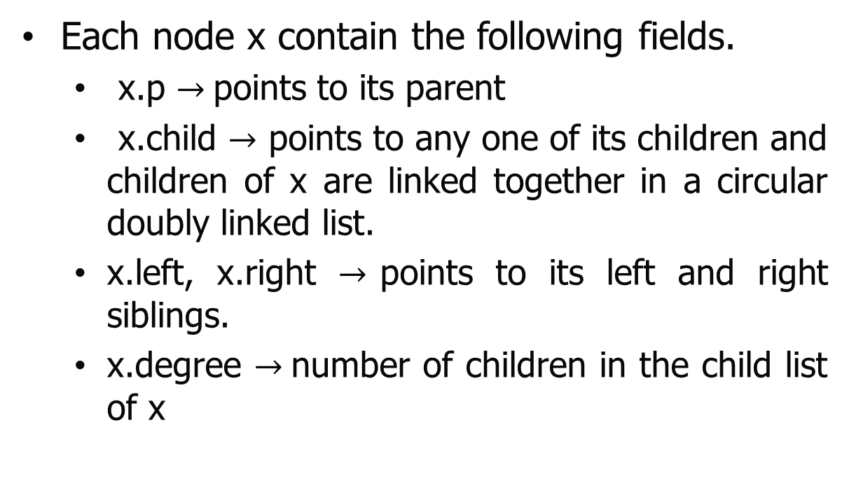
Fibonacci Heap (Structure)
Each node x contain the following fields.
x.p $→$points to its parent
x.child $→$ points to any one of its children and children of x are linked together in a circular doubly linked list.
x.left, x.right $→$points to its left and right siblings.
x.degree $→$number of children in the child list of x

Slide 7
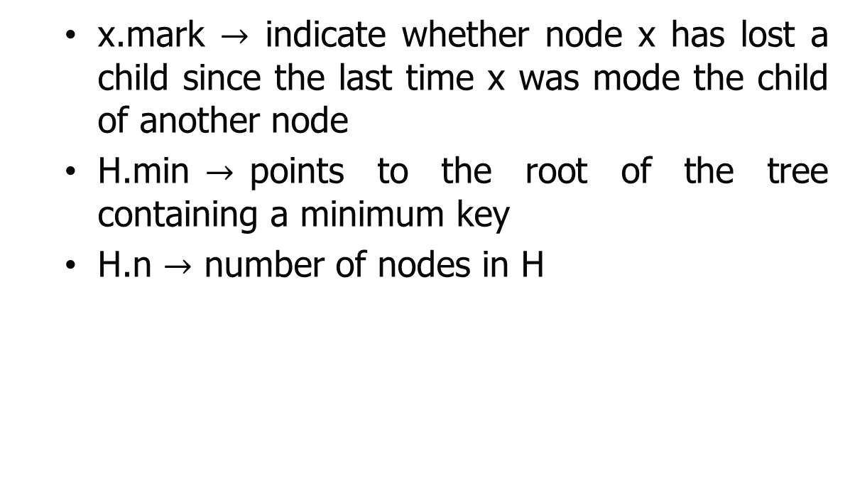
Fibonacci Heap(Structure)
x.mark $→$ indicate whether node x has lost a child since the last time x was mode the child of another node
H.min$→$points to the root of the tree containing a minimum key
H.n $→$ number of nodes in H

Slide 8
Fibonacci Heap(Structure)
An example of Fibonacci Heap with the help of doubly circular link list is given below.
H.min
23
7
3
17
24
18
52
38
30
26
46
39
41
35
H

Slide 9
Fibonacci Heap
The Fibonacci heap data structure serves a dual purpose.
First, it supports a set of operations that constitutes what is known as a “mergeable heap.”
Second, several Fibonacci-heap operations run in constant amortized time, which makes this data structure well suited for applications that invoke these operations frequently.

Slide 10
Fibonacci Heap
A mergeable heap is any data structure that supports the following seven operations, in which each element has a key:
MAKE-HEAP() creates and returns a new heap containing no elements.
MINIMUM(H) returns a pointer to the node in heap H whose key is minimum.
UNION(H1, H2) creates and returns a new heap that contains all the nodes of heaps H1 and H2. Heaps H1 and H2 are "destroyed" by this operation.
EXTRACT-MIN(H) deletes the node from heap H whose key is minimum, returning a pointer to the node.

Slide 11
Fibonacci Heap
INSERT(H, x) inserts node x, whose key field has already been filled in, into heap H.
DECREASE-KEY(H, x, k) assigns to node x within heap H the new key value k, which is assumed to be no greater than its current key value.[1]
DELETE(H, x) deletes node x from heap H

Slide 12
Fibonacci Heap
Heaps Analysis
Operation
Binary
Binomial
Fibonacci †
make-heap
1
1
1
insert
log N
log N
1
find-min
1
log N
1
delete-min
log N
log N
log N
union
N
log N
1
decrease-key
log N
log N
1
delete
log N
log N
log N
is-empty
1
1
1
Note: † amortized

Slide 13
Fibonacci Heap
Amortized Analysis
Analyze a sequence of operations on a data structure.
It shows that although some individual operations may be expensive, on average the cost per operation is small.
Average in this context does not mean that we’re averaging over a distribution of inputs.
No probability is involved.
We’re talking about average cost in the worst case.

Slide 14
Fibonacci Heap
The Three most common techniques used are
Aggregate Analysis
Accounting Method
Potential Method

Slide 15
Fibonacci Heap
The Three most common techniques used are
Aggregate Analysis
Accounting Method
Potential Method
The potential method is used to analyze the performance of Fibonacci heap operations.

Slide 16
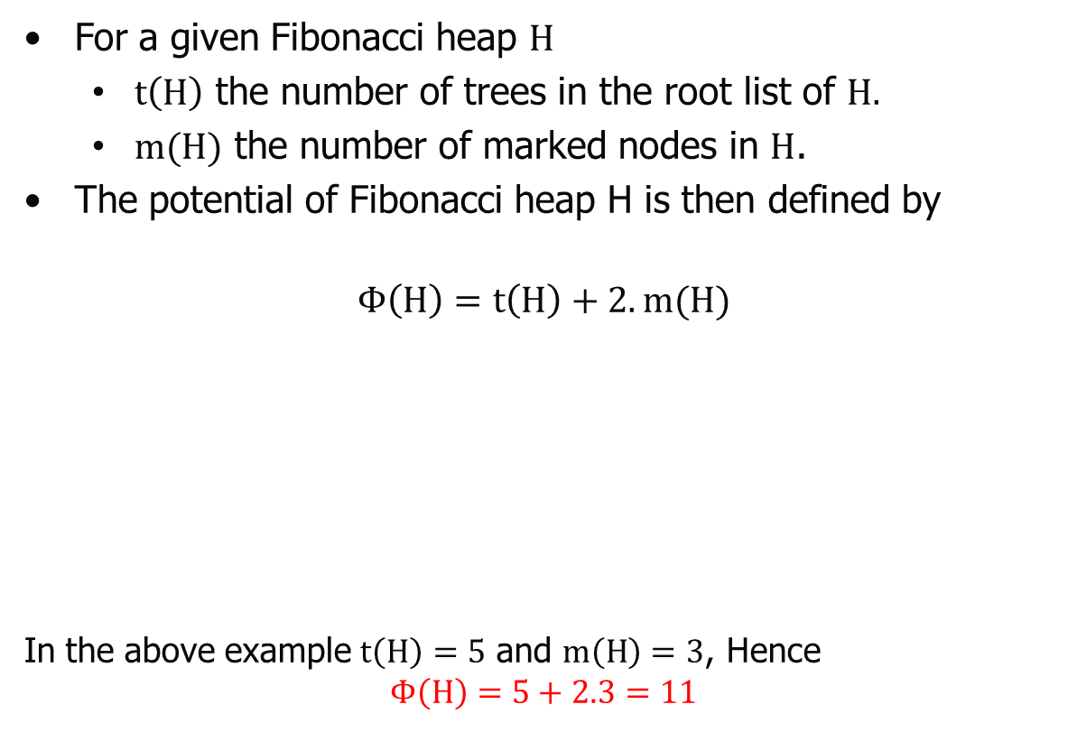
Fibonacci Heap
For a given Fibonacci heap $H$
$t\left(H\right)$ the number of trees in the root list of $H.$
$m(H)$ the number of marked nodes in $H$.
The potential of Fibonacci heap H is then defined by
$$Φ\left(H\right)=t\left(H\right)+2.m(H)$$
In the above example $t\left(H\right)=5$ and $m\left(H\right)=3$, Hence
$$Φ\left(H\right)=5+2.3=11$$
marked nodes in H
Fibonacci heap
Number of trees in the rooted list of H
H.min
23
7
3
17
24
18
52
38
30
26
46
39
41
35

Slide 17
Fibonacci Heap
Fibonacci heap application begins with no heaps. Hence
The initial potential is 0(zero) and the potential is nonnegative at all subsequent times.
An upper bound on the total amortized cost is thus an upper bound on the total actual cost for the sequence of operations.
Maximum degree
The amortized analyses was performed with a known upper bound D(n) on the maximum degree of any node in an n-node Fibonacci heap. (i.e. D(n) ≤ ⌊lg n⌋).

Slide 18
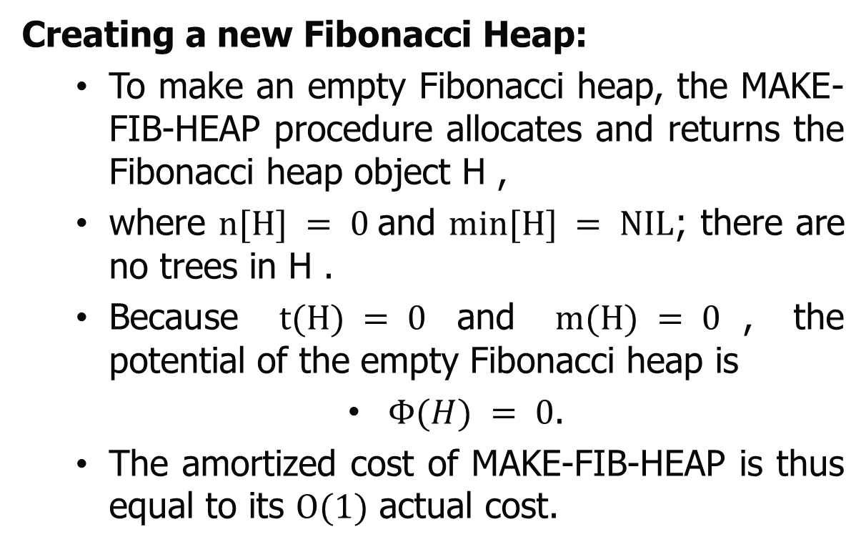
Fibonacci Heap (Operations)
Creating a new Fibonacci Heap:
To make an empty Fibonacci heap, the MAKE-FIB-HEAP procedure allocates and returns the Fibonacci heap object H ,
where $n[H] = 0$and $min⁡[H] = NIL$; there are no trees in H .
Because $t(H) = 0$and $m(H) = 0$, the potential of the empty Fibonacci heap is
$Φ(H) = 0$.
The amortized cost of MAKE-FIB-HEAP is thus equal to its $O(1)$ actual cost.

Slide 19
Fibonacci Heap (Operations)
Inserting a node:
To insert a node in Fibonacci heap the following steps will be used.
Step1 :Create a new singleton tree.
Step2 : Add to left of min pointer.
Step3 : Update min pointer.

Slide 20
Fibonacci Heap (Operations)
Inserting a node:
Example: Insert the node 21 in following Fibonacci heap
H.min
23
7
3
17
24
18
52
38
30
26
46
39
41
35

Slide 21
Fibonacci Heap (Operations)
Inserting a node:
Example: Insert the node 21 in following Fibonacci heap
Insert
21
H.min
23
7
3
17
24
18
52
38
30
26
46
39
41
35

Slide 22
Fibonacci Heap (Operations)
Inserting a node:
Example: Insert the node 21 in following Fibonacci heap
23
7
21
3
17
24
18
52
38
30
26
46
39
41
35

Slide 23
Fibonacci Heap (Operations)
Inserting a node:
The following procedure inserts node x into Fibonacci heap H , assuming that the node has already been allocated and that key[x] has already been filled in.
FIB-HEAP-INSERT(H, x)
1 degree[x] ← 0
2 p[x] ← NIL
3 child[x] ← NIL
4 left[x] ← x
5 right[x] ← x
6 mark[x] ← FALSE
7 concatenate the root list containing x with root list H
8 if min[H] = NIL or key[x] < key[min[H]]
9 then min[H] ← x
10 n[H] ← n[H] + 1

Slide 24
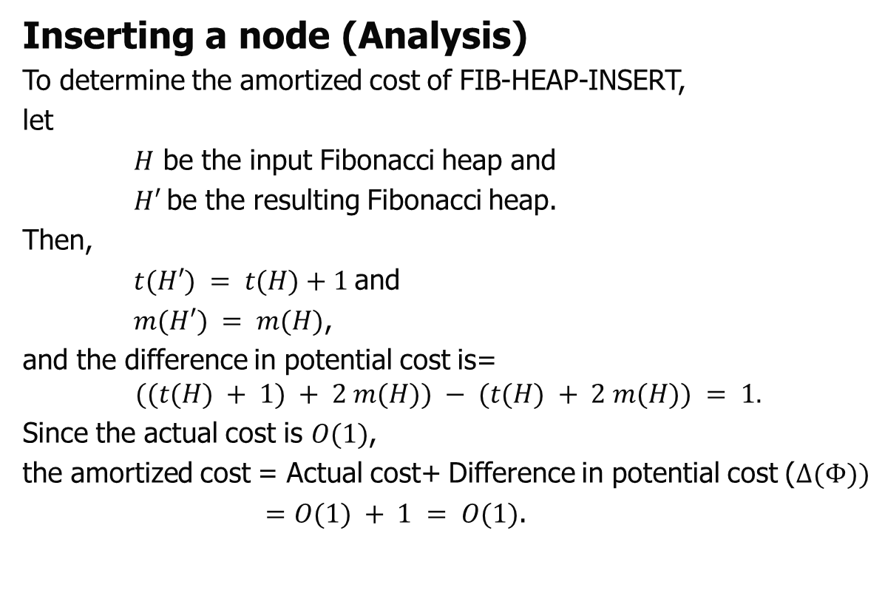
Fibonacci Heap (Operations)
Inserting a node (Analysis)
To determine the amortized cost of FIB-HEAP-INSERT,
let
$H$ be the input Fibonacci heap and
$H′$be the resulting Fibonacci heap.
Then,
$t(H′) = t(H)+1$and
$m(H′) = m(H)$,
and the difference in potential cost is=
$$((t(H) + 1) + 2 m(H)) − (t(H) + 2 m(H)) = 1.$$
Since the actual cost is $O(1)$,
the amortized cost = Actual cost+ Difference in potential cost ($Δ(Φ))$
$=O(1) + 1 = O(1)$.

Slide 25
Fibonacci Heap (Operations)
Finding the minimum node
The minimum node of a Fibonacci heap H is given by the pointer min[H],
So the actual time for finding the minimum node is O(1). Because the potential of H does not change, and the amortized cost of this operation is equal to its O(1) actual cost.

Slide 26
Fibonacci Heap (Operations)
Uniting two Fibonacci heaps
This procedure unites Fibonacci heaps H1 and H2, destroying H1 and H2 in the process. It simply concatenates the root lists of H1 and H2 and then determines the new minimum node.
Basic Idea:
Step 1: Concatenate two Fibonacci heaps.
Step 2: Root lists are circular, doubly linked lists.

Slide 27
Fibonacci Heap (Operations)
Uniting two Fibonacci heaps
FIB-HEAP-UNION(H1, H2)
1 H ← MAKE-FIB-HEAP()
2 min[H] ← min[H1]
3 Concatenate the root list of H2 with the root list of H
4 if (min[H1] = NIL) or (min[H2] ≠ NIL and min[H2] < min[H1])
5 then min[H] ← min[H2]
6 n[H] ← n[H1] + n[H2]
7 free the objects H1 and H2
8 return H

Slide 28


Fibonacci Heap (Operations)
Uniting two Fibonacci heaps
Example : Apply FIB-HEAP-UNION(H1, H2) for uniting the following two Fibonacci Heaps
$$H_{1}$$
23
7
21
3
$$H_{2}$$
17
24
18
52
38
30
26
46
39
41
35

Slide 29

Fibonacci Heap (Operations)
Uniting two Fibonacci heaps
Example : Apply FIB-HEAP-UNION(H1, H2) for uniting the following two Fibonacci Heaps
$$H_{1}$$
23
7
21
3
$$H_{2}$$
17
24
18
52
38
30
26
46
39
41
35
$$H$$
23
7
21
3
17
24
18
52
38
30
26
46
39
41
35

Slide 30
Fibonacci Heap (Operations)
Uniting two Fibonacci heaps (Analysis)
FIB-HEAP-UNION(H1, H2)
1 H ← MAKE-FIB-HEAP()
2 min[H] ← min[H1]
3 Concatenate the root list of H2 with the root list of H
4 if (min[H1] = NIL) or (min[H2] ≠ NIL and min[H2] < min[H1])
5 then min[H] ← min[H2]
6 n[H] ← n[H1] + n[H2]
7 free the objects H1 and H2
return H
Lines 1-3 concatenate the root lists of H1 and H2 into a new root list H.
Lines 2, 4, and 5 set the minimum node of H ,
and line 6 sets n[H] to the total number of nodes.
The Fibonacci heap objects H1 and H2 are freed in line 7, and line 8 returns the resulting Fibonacci heap H.

Slide 31
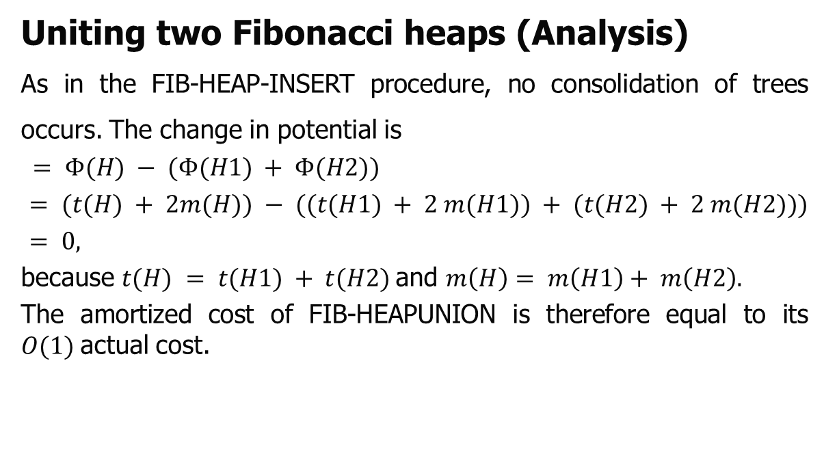
Fibonacci Heap (Operations)
Uniting two Fibonacci heaps (Analysis)
As in the FIB-HEAP-INSERT procedure, no consolidation of trees occurs. The change in potential is
$$= Φ(H) − (Φ(H1) + Φ(H2))$$
$= (t(H) + 2m(H)) − ((t(H1) + 2 m(H1)) + (t(H2) + 2 m(H2)))$
$= 0,$
because $t(H) = t(H1) + t(H2)$and $m\left(H\right)= m\left(H1\right)+ m\left(H2\right).$
The amortized cost of FIB-HEAPUNION is therefore equal to its $O(1)$actual cost.

Slide 32
Fibonacci Heap (Operations)
Extracting the minimum node
The process of extracting the minimum node is the most complicated of the operations presented in this section.
Basic Idea:
Step 1: Delete min and concatenate its children into root list.
Step 2: Consolidate trees so that no two roots have same degree.

Slide 33
Fibonacci Heap (Operations)
Extracting the minimum node
FIB-HEAP-EXTRACT-MIN(H)
1 z ← min[H]
2 if z ≠ NIL
3 then for each child x of z
4 do add x to the root list of H
5 p[x] ← NIL
6 remove z from the root list of H
7 if z = right[z]
8 then min[H] ← NIL
9 else min[H] ← right[z]
10 CONSOLIDATE(H)
11 n[H] ← n[H] - 1
12 return z.

Slide 34
Fibonacci Heap (Operations)
Extracting the minimum node
Example: Extract the minimum element from the following Fibonacci heap.
H.min
23
7
21
3
17
24
18
52
38
30
26
46
39
41
35

Slide 35
Fibonacci Heap (Operations)
Extracting the minimum node
H.min
23
7
21
3
17
24
Delete 3
18
52
38
30
26
46
39
41
35

Slide 36
Fibonacci Heap (Operations)
Extracting the minimum node
H.min
23
7
21
3
17
24
18
52
38
30
26
46
After Delete 3
39
41
35
H.min
23
7
21
18
52
38
17
24
39
41
30
26
46
35

Slide 37
Fibonacci Heap (Operations)
Extracting the minimum node
H.min
23
7
21
18
52
38
17
24
Apply Consolidate()
39
41
30
26
46
35

Slide 38
Fibonacci Heap (Operations)
Extracting the minimum node
H.min
23
7
21
18
52
38
17
24
Apply Consolidate()
39
41
30
26
46
0 1 2 3 4
35
A
w,x
23
7
21
18
52
38
17
24
39
41
30
26
46
35

Slide 39
Fibonacci Heap (Operations)
Extracting the minimum node
0 1 2 3 4
A
w, x
23
7
21
18
52
38
17
24
39
41
30
26
46
0 1 2 3 4
35
A
w, x
23
7
21
18
52
38
17
24
39
41
30
26
46
35

Slide 40
Fibonacci Heap (Operations)
Extracting the minimum node
0 1 2 3 4
A
w, x
23
7
21
18
52
38
17
24
39
41
30
26
46
0 1 2 3 4
35
A
w,x
23
7
21
18
52
38
17
24
39
41
30
26
46
35

Slide 41
Fibonacci Heap (Operations)
Extracting the minimum node
0 1 2 3 4
A
w,x
23
7
21
18
52
38
17
24
39
41
30
26
46
0 1 2 3 4
35
A
x
7
21
18
52
38
17
24
23
w
39
41
30
26
46
35

Slide 42
Fibonacci Heap (Operations)
Extracting the minimum node
0 1 2 3 4
A
x
7
21
18
52
38
17
24
23
w
39
41
30
26
46
0 1 2 3 4
A
35
x
7
21
18
52
38
24
23
17
w
39
41
26
46
30
35

Slide 43
Fibonacci Heap (Operations)
Extracting the minimum node
0 1 2 3 4
A
x
7
21
18
52
38
24
23
17
w
39
41
26
46
30
0 1 2 3 4
A
35
x
7
21
18
52
38
24
17
23
w
39
41
26
46
30
35

Slide 44
Fibonacci Heap (Operations)
Extracting the minimum node
0 1 2 3 4
A
x
7
21
18
52
38
24
17
23
w
39
41
26
46
30
0 1 2 3 4
A
35
w, x
7
21
18
52
38
24
17
23
39
41
26
46
30
35

Slide 45
Fibonacci Heap (Operations)
Extracting the minimum node
0 1 2 3 4
A
w, x
7
21
18
52
38
24
17
23
39
41
26
46
30
0 1 2 3 4
35
A
w, x
7
21
18
52
38
24
17
23
39
41
26
46
30
35

Slide 46
Fibonacci Heap (Operations)
Extracting the minimum node
0 1 2 3 4
A
w, x
7
21
18
52
38
24
17
23
39
41
26
0 1 2 3 4
46
30
A
35
w, x
7
18
38
24
17
23
21
39
41
26
46
30
52
35

Slide 47
Fibonacci Heap (Operations)
Extracting the minimum node
0 1 2 3 4
A
w, x
7
18
38
24
17
23
21
39
41
26
46
30
52
0 1 2 3 4
35
A
w, x
7
18
38
24
17
23
21
39
41
26
46
30
52
35

Slide 48
Fibonacci Heap (Operations)
Extracting the minimum node
0 1 2 3 4
A
w, x
7
18
38
24
17
23
21
39
41
26
46
30
52
35
H.min
7
18
38
24
17
23
21
39
41
26
46
30
52
35

Slide 49
Fibonacci Heap (Operations)
Extracting the minimum node
CONSOLIDATE(H)
1 for i ← 0 to D(n[H])
2 do A[i] ← NIL
3 for each node w in the root list of H
4 do x ← w
5 d ← degree[x]
6 while A[d] ≠ NIL
7 do y ← A[d] ▹ Another node with the same degree as x.
8 if key[x] > key[y]
9 then exchange x ↔ y
10 FIB-HEAP-LINK(H, y, x)
11 A[d] ← NIL
12 d ← d + 1
13 A[d] ← x

Slide 50
Fibonacci Heap (Operations)
Extracting the minimum node
14 min[H] ← NIL
15 for i ← 0 to D(n[H])
16 do if A[i] ≠ NIL
17 then add A[i] to the root list of H
18 if min[H] = NIL or key[A[i]] < key[min[H]]
19 then min[H] ← A[i]
FIB-HEAP-LINK(H, y, x)
1 remove y from the root list of H
2 make y a child of x, incrementing degree[x]
3 mark[y] ← FALSE

Slide 51
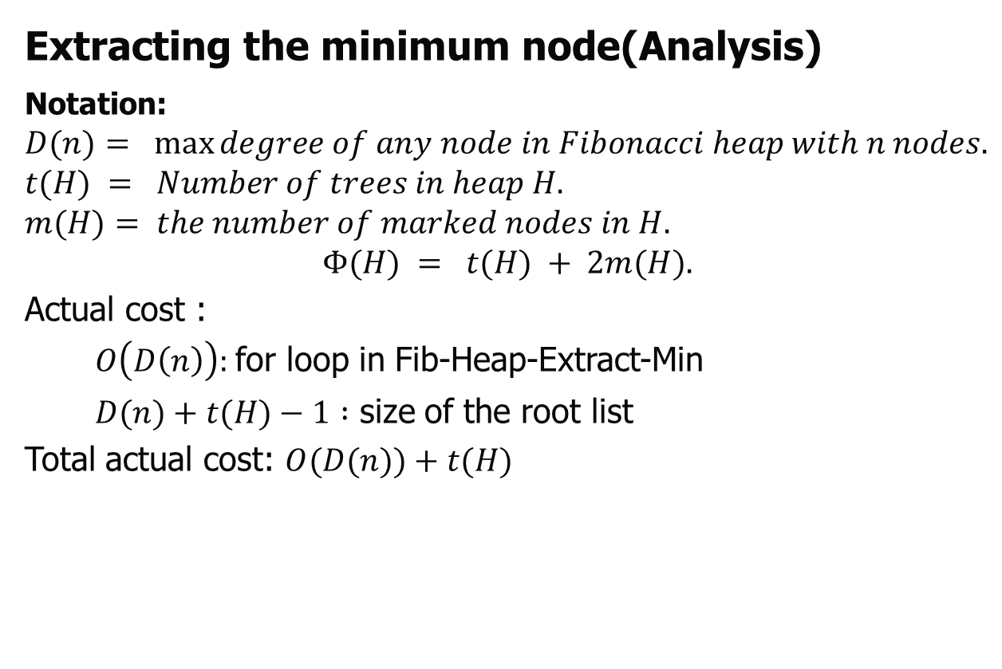
Fibonacci Heap (Operations)
Extracting the minimum node(Analysis)
Notation:
$$D(n)= max⁡degree of any node in Fibonacci heap with n nodes.$$
$$t(H) = Number of trees in heap H.$$
$$m(H)= the number of marked nodes in H.$$
$$Φ(H) = t(H) + 2m(H).$$
Actual cost :
$O\left(D\left(n\right)\right):$for loop in Fib-Heap-Extract-Min
$D(n)+t(H)−1 :$ size of the root list
Total actual cost: $O(D(n))+t(H)$

Slide 52
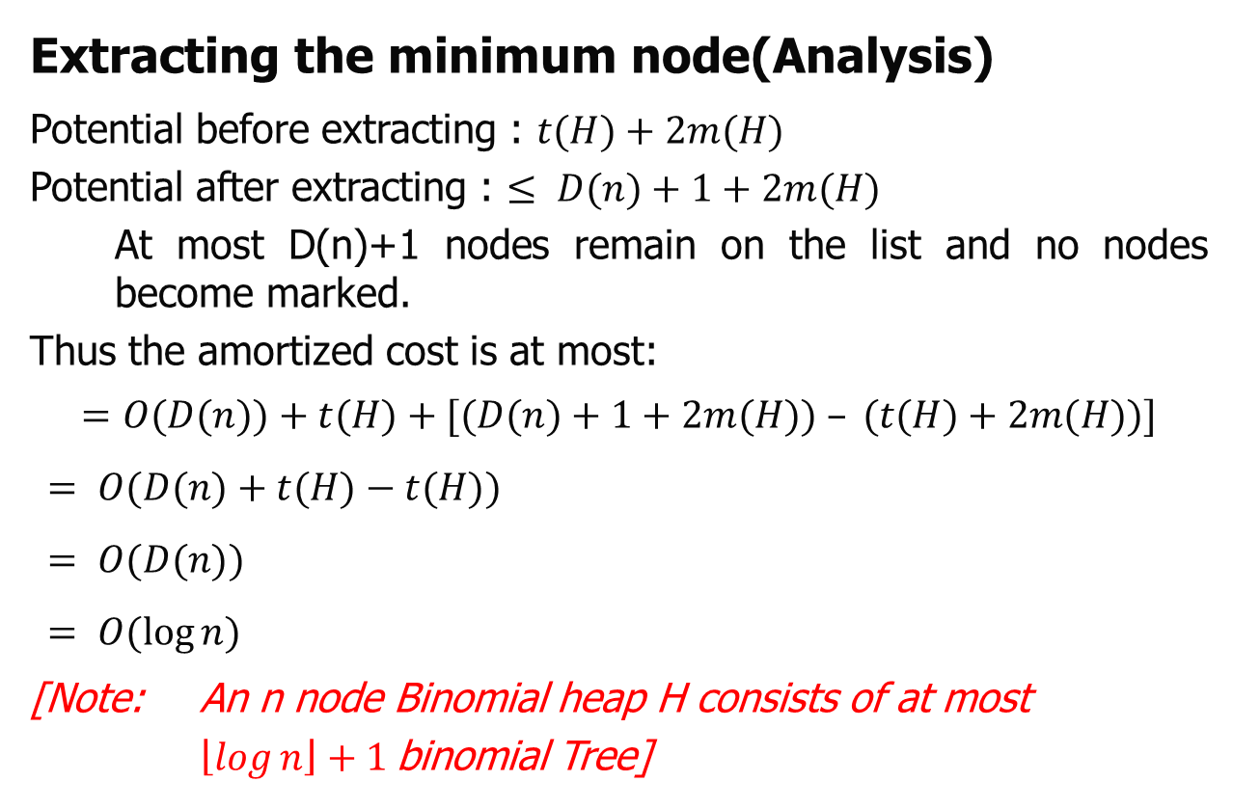
Fibonacci Heap (Operations)
Extracting the minimum node(Analysis)
Potential before extracting : $t(H)+2m(H)$
Potential after extracting : $≤ D(n)+1+2m(H)$
At most D(n)+1 nodes remain on the list and no nodes become marked.
Thus the amortized cost is at most:
$$=O(D(n))+t(H)+[(D(n)+1+2m(H)) – (t(H)+2m(H))]$$
$$= O(D(n)+t(H)−t(H))$$
$$= O(D(n))$$
$$= O(\log{n})$$
[Note: An n node Binomial heap H consists of at most
$\left\lfloor \log{n}\right\rfloor +1$binomial Tree]

Slide 53
Fibonacci Heap (Operations)
Decreasing a key
This pseudocode for the operation FIB-HEAP-DECREASE-KEY, work with an assumption that removing a node from a linked list does not change any of the structural fields in the removed node.

Slide 54
Fibonacci Heap (Operations)
Decreasing a key
Basic Idea:
Case 0: min-heap property not violated.
decrease key of x to k
change heap min pointer if necessary
Example:
Decrease 46 to 45.
min
7
18
38
24
17
23
21
39
41
26
46
46
30
52
x
35

Slide 55
Fibonacci Heap (Operations)
Decreasing a key
Basic Idea:
Case 0: min-heap property not violated.
decrease key of x to k
change heap min pointer if necessary
Example:
Decrease 46 to 45.
min
7
18
38
24
17
23
21
39
41
26
46
45
30
52
x
35

Slide 56
Fibonacci Heap (Operations)
Decreasing a key
Basic Idea:
Case 1: parent of x is unmarked.
decrease key of x to k
cut off link between x and its parent
mark parent
add tree rooted at x to root list, updating heap min pointer

Slide 57
Fibonacci Heap (Operations)
Decreasing a key and deleting node
Basic Idea:
Case 1: parent of x is unmarked.
decrease key of x to k
cut off link between x and its parent
mark parent
add tree rooted at x to root list, updating heap min pointer
Decrease 45 to 15.
min
7
18
38
24
17
23
21
39
41
26
46
45
30
52
x
35

Slide 58
Fibonacci Heap (Operations)
Decreasing a key
Basic Idea:
Case 1: parent of x is unmarked.
decrease key of x to k
cut off link between x and its parent
mark parent
add tree rooted at x to root list, updating heap min pointer
Decrease 45 to 15.
min
7
18
38
24
17
23
21
39
41
26
15
30
52
x
35

Slide 59
Fibonacci Heap (Operations)
Decreasing a key
Basic Idea:
Case 1: parent of x is unmarked.
decrease key of x to k
cut off link between x and its parent
mark parent
add tree rooted at x to root list, updating heap min pointer
Decrease 45 to 15.
min
7
18
38
24
17
23
21
39
41
26
15
30
52
x
35

Slide 60
Fibonacci Heap (Operations)
Decreasing a key
Basic Idea:
Case 1: parent of x is unmarked.
decrease key of x to k
cut off link between x and its parent
mark parent
add tree rooted at x to root list, updating heap min pointer
Decrease 45 to 15.
min
7
18
38
24
17
23
21
39
41
26
15
30
52
x
35

Slide 61
Fibonacci Heap (Operations)
Decreasing a key
Basic Idea:
Case 1: parent of x is unmarked.
decrease key of x to k
cut off link between x and its parent
mark parent
add tree rooted at x to root list, updating heap min pointer
min
15
7
18
38
x
24
17
23
21
39
41
Decrease 45 to 15.
26
30
52
35

Slide 62
Fibonacci Heap (Operations)
Decreasing a key
Basic Idea:
Case 2: parent of x is marked.
decrease key of x to k
cut off link between x and its parent p[x], and add x to root list
cut off link between p[x] and p[p[x]], add p[x] to root list
If p[p[x]] unmarked, then mark it.
If p[p[x]] marked, cut off p[p[x]], unmark, and repeat.

Slide 63
Fibonacci Heap (Operations)
Decreasing a key
Basic Idea:
Case 2: parent of x is marked.
decrease key of x to k
cut off link between x and its parent p[x], and add x to root list
cut off link between p[x] and p[p[x]], add p[x] to root list
If p[p[x]] unmarked, then mark it.
If p[p[x]] marked, cut off p[p[x]], unmark, and repeat.
min
15
7
18
38
24
17
23
21
39
41
Decrease 35 to 5.
26
30
52
35
x

Slide 64
Fibonacci Heap (Operations)
Decreasing a key
Basic Idea:
Case 2: parent of x is marked.
decrease key of x to k
cut off link between x and its parent p[x], and add x to root list
cut off link between p[x] and p[p[x]], add p[x] to root list
If p[p[x]] unmarked, then mark it.
If p[p[x]] marked, cut off p[p[x]], unmark, and repeat.
min
15
7
18
38
24
17
23
21
39
41
Decrease 35 to 5.
26
30
52
5
x

Slide 65
Fibonacci Heap (Operations)
Decreasing a key
Basic Idea:
Case 2: parent of x is marked.
decrease key of x to k
cut off link between x and its parent p[x], and add x to root list
cut off link between p[x] and p[p[x]], add p[x] to root list
If p[p[x]] unmarked, then mark it.
If p[p[x]] marked, cut off p[p[x]], unmark, and repeat.
min
15
5
7
18
38
x
24
17
23
21
39
41
Decrease 35 to 5.
26
30
52

Slide 66
Fibonacci Heap (Operations)
Decreasing a key
Basic Idea:
Case 2: parent of x is marked.
decrease key of x to k
cut off link between x and its parent p[x], and add x to root list
cut off link between p[x] and p[p[x]], add p[x] to root list
If p[p[x]] unmarked, then mark it.
If p[p[x]] marked, cut off p[p[x]], unmark, and repeat.
min
15
5
26
7
18
38
x
24
17
23
21
39
41
Decrease 35 to 5.
30
52

Slide 67
Fibonacci Heap (Operations)
Decreasing a key
Basic Idea:
Case 2: parent of x is marked.
decrease key of x to k
cut off link between x and its parent p[x], and add x to root list
cut off link between p[x] and p[p[x]], add p[x] to root list
If p[p[x]] unmarked, then mark it.
If p[p[x]] marked, cut off p[p[x]], unmark, and repeat.
min
15
5
26
24
7
18
38
x
17
23
21
39
41
Decrease 35 to 5.
30
52

Slide 68
Fibonacci Heap (Operations)
Decreasing a key
FIB-HEAP-DECREASE-KEY(H, x, k)
1 if k > key[x]
2 then error "new key is greater than current key"
3 key[x] ← k
4 y ← p[x]
5 if y ≠ NIL and key[x] < key[y]
6 then CUT(H, x, y)
7 CASCADING-CUT(H, y)
8 if key[x] < key[min[H]]
9 then min[H] ← x

Slide 69
Fibonacci Heap (Operations)
Decreasing a key
CUT(H, x, y)
1 remove x from the child list of y, decrementing degree[y]
2 add x to the root list of H
3 p[x] ← NIL
4 mark[x] ← FALSE
CASCADING-CUT(H, y)
1 z ← p[y]
2 if z ≠ NIL
3 then if mark[y] = FALSE
4 then mark[y] ← TRUE
5 else CUT(H, y, z)
6 CASCADING-CUT(H, z)
The amortized cost of Fibonacci

Slide 70
Fibonacci Heap (Operations)
Decreasing a key (Analysis)
The FIB-HEAP-DECREASE-KEY procedure takes O(1) time, plus the time to perform the cascading cuts.
Suppose that CASCADING-CUT is recursively called c times from a given invocation of FIB-HEAP-DECREASE-KEY.
Each call of CASCADING-CUT takes O(1) time exclusive of recursive calls.
Thus, the actual cost of FIB-HEAP-DECREASE-KEY, including all recursive calls, is O(c)

Slide 71
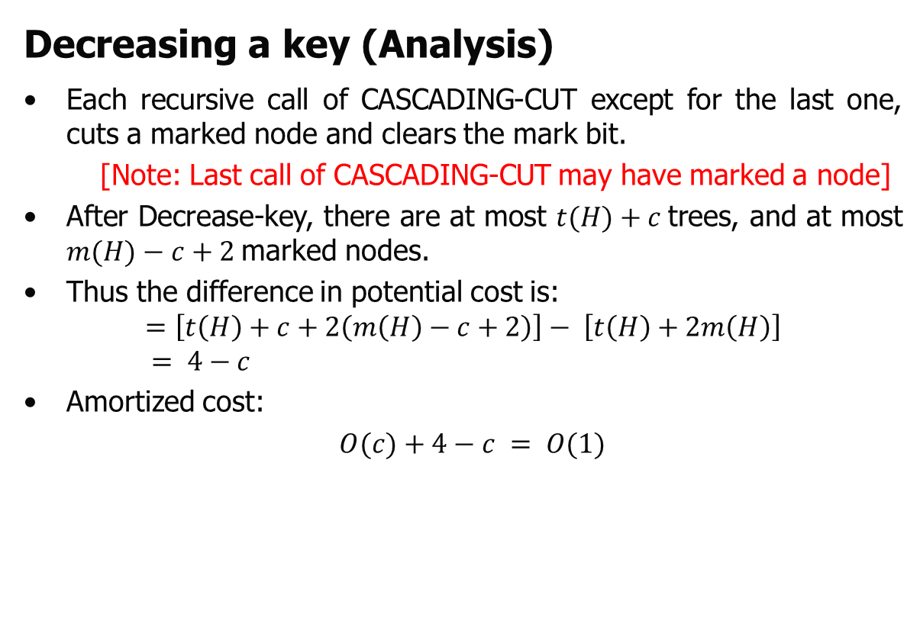
Fibonacci Heap (Operations)
Decreasing a key (Analysis)
Each recursive call of CASCADING-CUT except for the last one, cuts a marked node and clears the mark bit.
[Note: Last call of CASCADING-CUT may have marked a node]
After Decrease-key, there are at most $t(H)+c$trees, and at most $m(H)−c+2$marked nodes.
Thus the difference in potential cost is:
$$=\left[t\left(H\right)+c+2\left(m\left(H\right)−c+2\right)\right]− \left[t\left(H\right)+2m\left(H\right)\right]$$
$$= 4−c$$
Amortized cost:
$O(c)+4−c = O(1)$

Slide 72
Fibonacci Heap (Operations)
Deleting a node
It is easy to delete a node from an n-node Fibonacci heap in O(D(n)) amortized time, as is
done by the following pseudocode. We assume that there is no key value of -∞ currently in the Fibonacci heap.
FIB-HEAP-DELETE(H, x)
1 FIB-HEAP-DECREASE-KEY(H, x, -∞)
2 FIB-HEAP-EXTRACT-MIN(H)

Slide 73
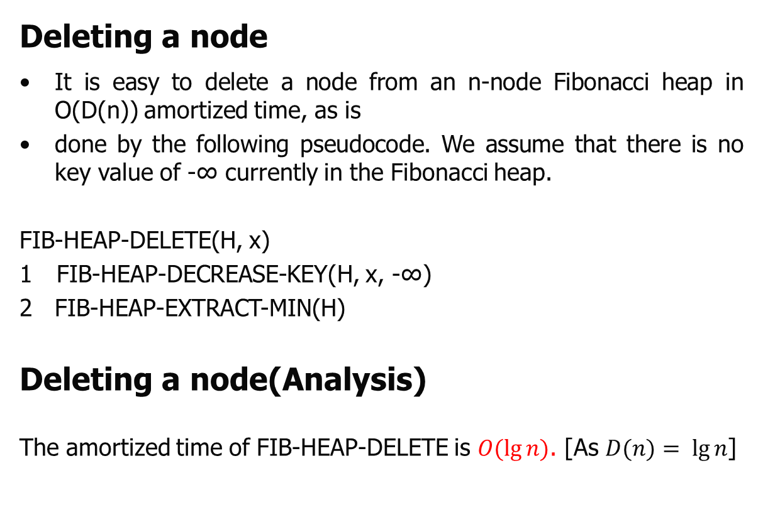
Fibonacci Heap (Operations)
Deleting a node
It is easy to delete a node from an n-node Fibonacci heap in O(D(n)) amortized time, as is
done by the following pseudocode. We assume that there is no key value of -∞ currently in the Fibonacci heap.
FIB-HEAP-DELETE(H, x)
1 FIB-HEAP-DECREASE-KEY(H, x, -∞)
FIB-HEAP-EXTRACT-MIN(H)
Deleting a node(Analysis)
The amortized time of FIB-HEAP-DELETE is $O(lg⁡n)$. [As $D(n)= lg⁡n$]

Slide 74

Thank U

